Slide 1
Digital Technology Improves Life

Slide 2
CONTENTS
01
02
03
company Introduction
Full Dental CAD/CAM Solution
Marketing
Events & Support
01. Who we are
02. UP3D at a glance
03. UP3D around the world
04. Affiliations and partnerships
01. 3D dental scanner
02. Dental milling machines
03. CAD & CAM software
01. Magazine
02. Exhibitions
03. Support
Digital Technology Improves Life

Slide 3
01
Company
Introduction

Slide 4
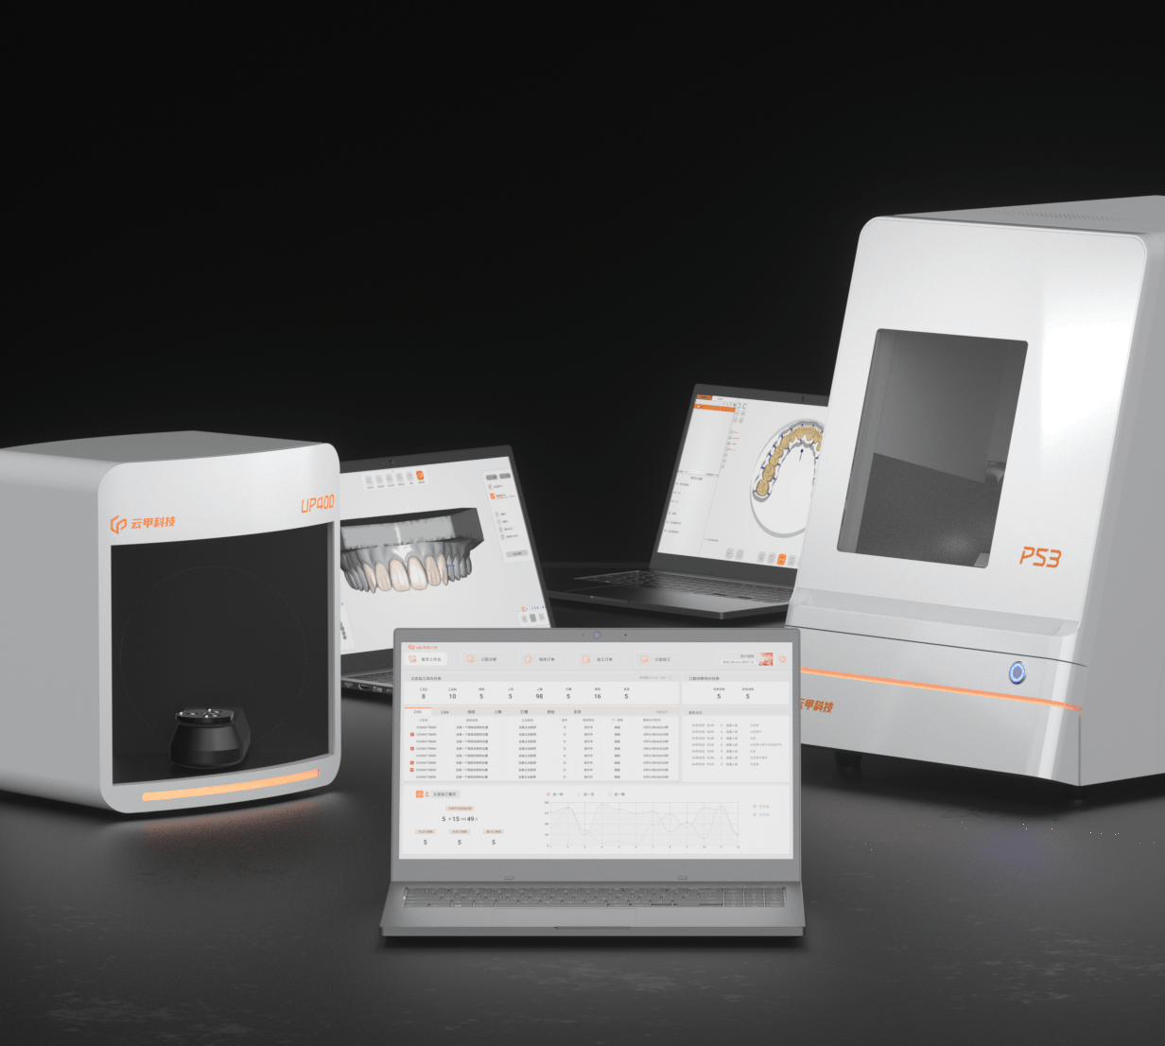
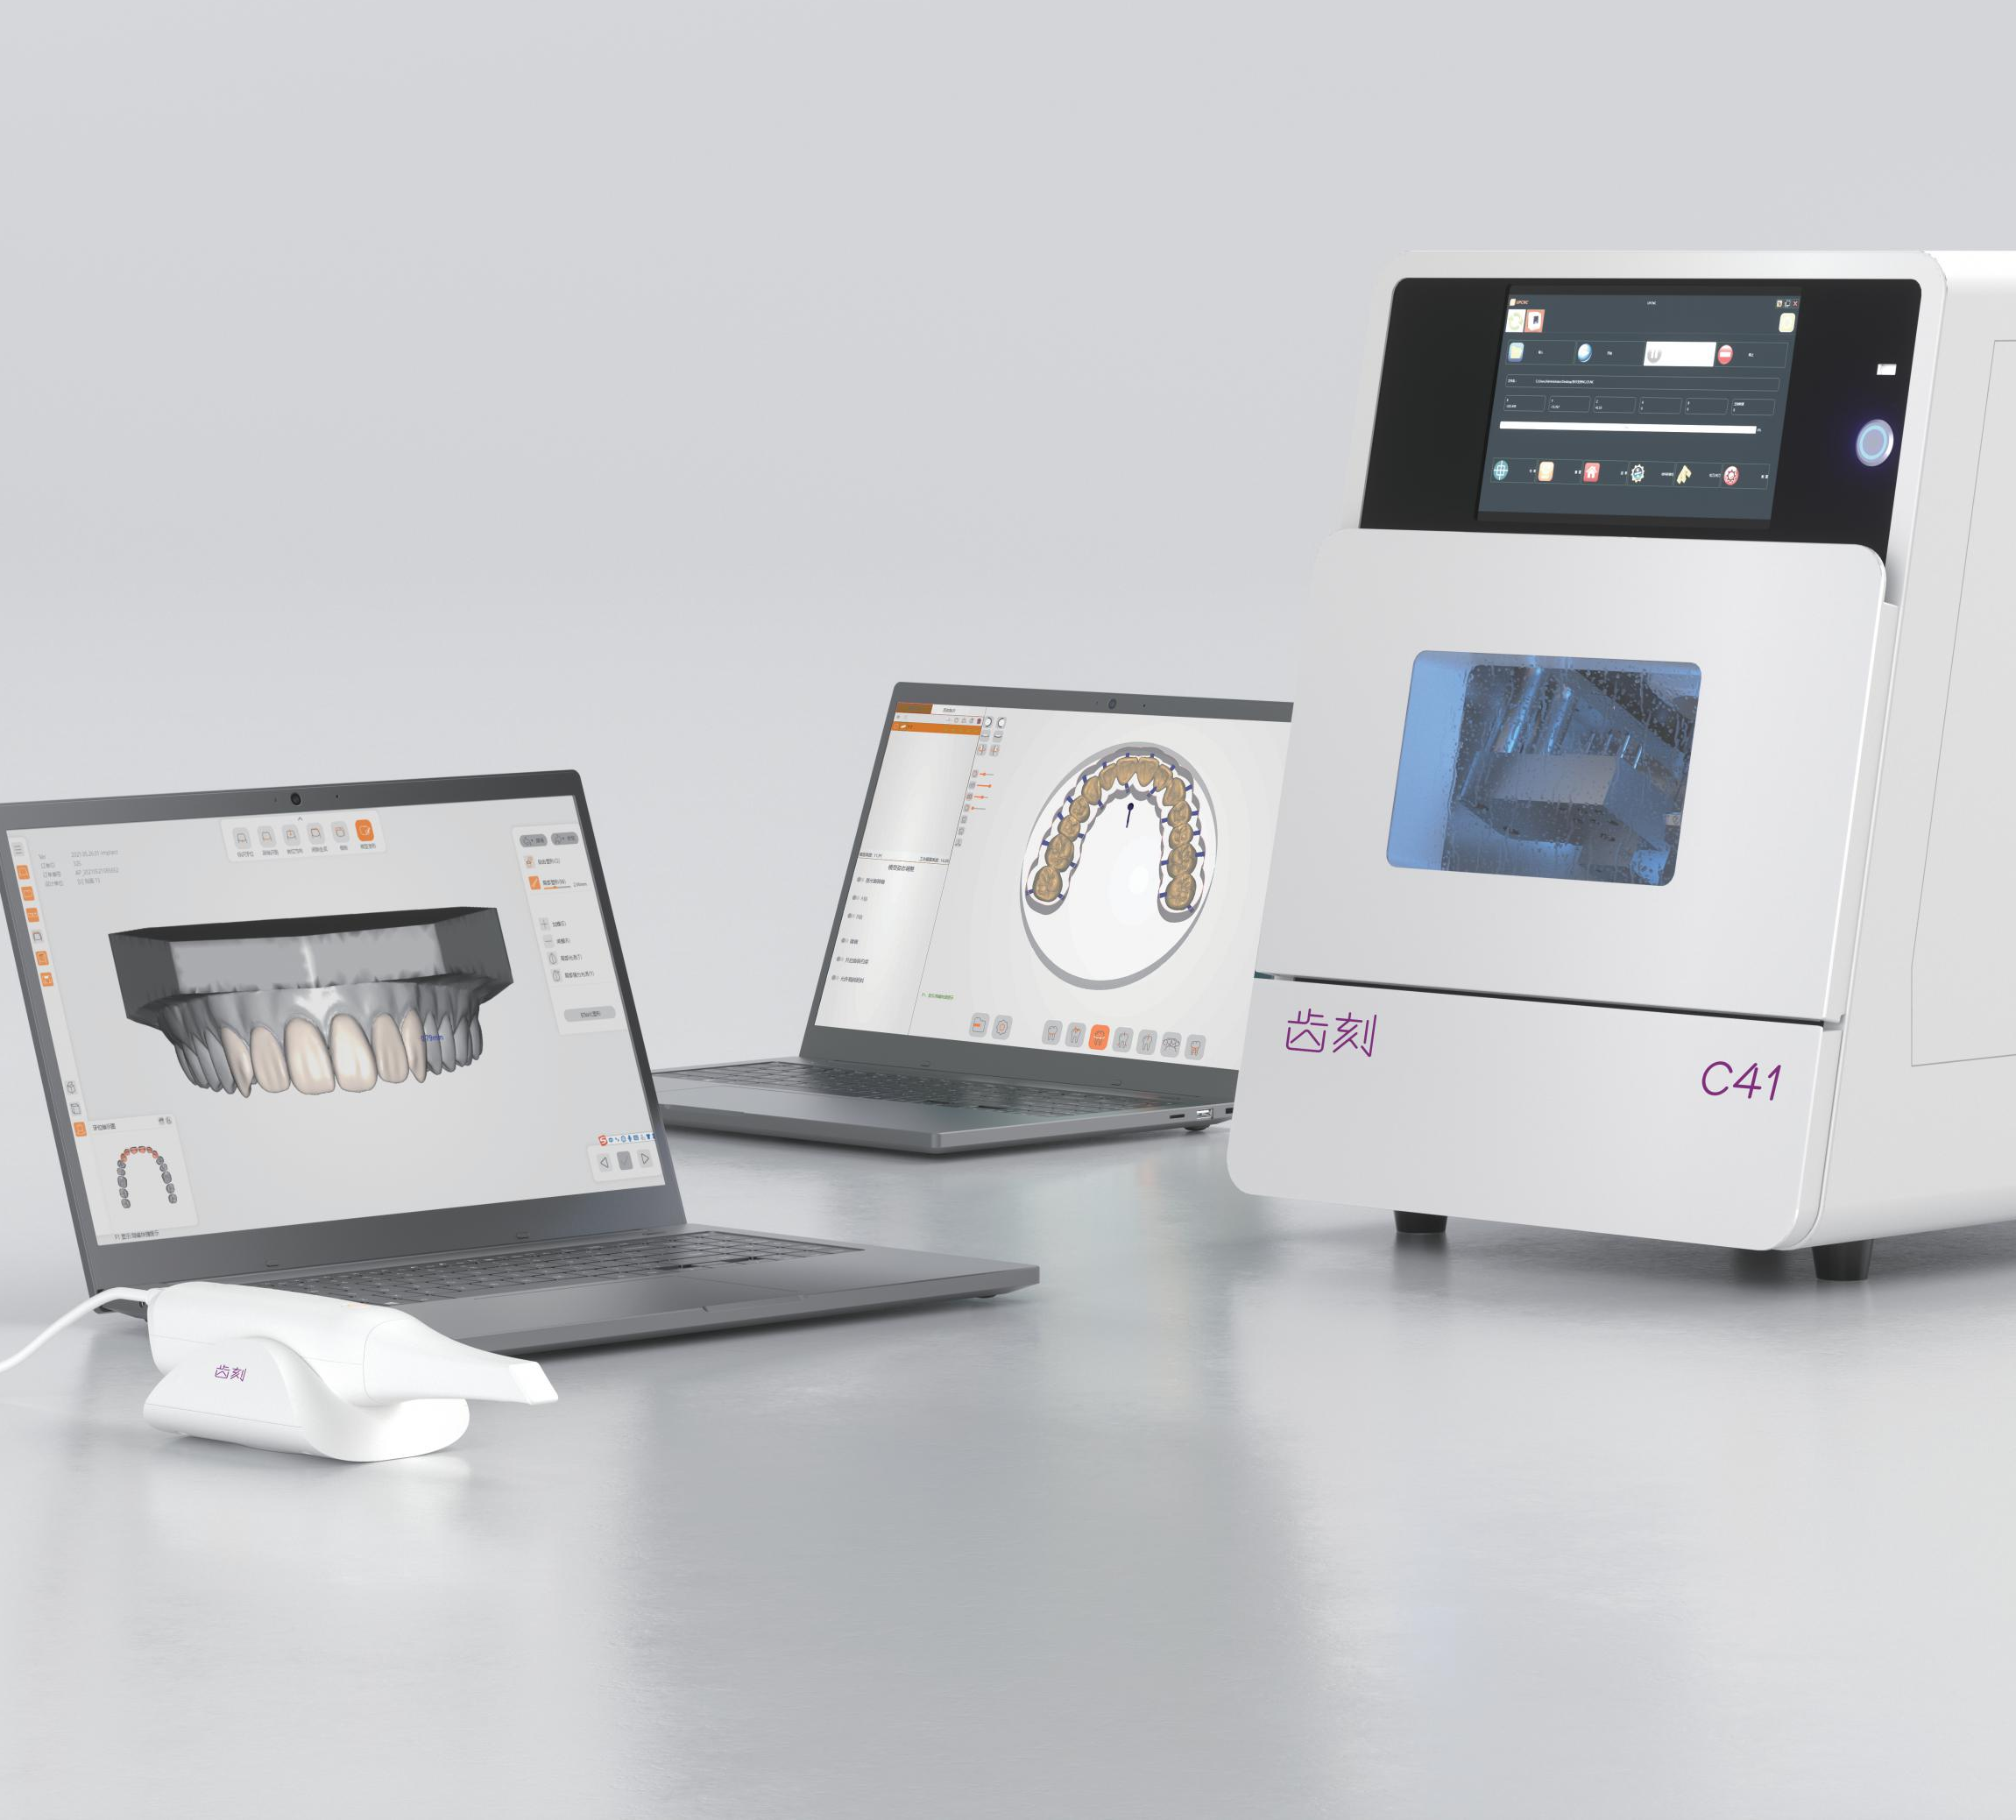
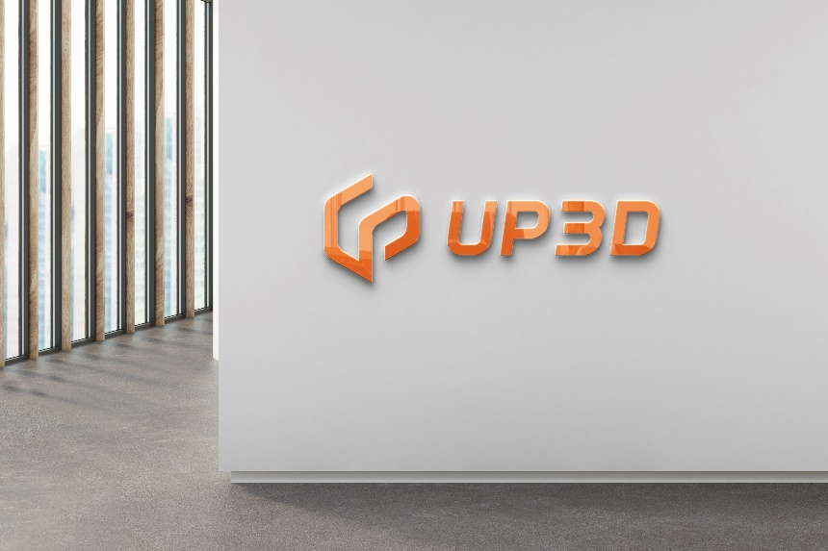
Company Summary
UP3D is a high tech company which was established in 2013, headquartered in the Nanshan district of Shenzhen, one of the most dynamic and creative cities in the world.
As one of the only few companies in the world that are capable of developing a full dental CAD/CAM solution including software and hardware, we are committed to providing our worldwide customers with brand new dental CAD/CAM solution.
Digital Technology Improves Life
Notes:
深圳云甲科技有限公司是中国首家独立自主研发义齿计算机辅助设计软件的公司，公司创始至今专注于齿科CAD/CAM软硬件全系统解决方案的研发和制造，已获得多项发明专利和技术突破。是国家高新技术企业，深圳市高新技术企业，三维图形图像处理技术及其应用专家。
秉承创新服务和追求卓越的企业精神，云甲人致力于为中国乃至全球口腔市场提供高品质的数字化解决方案，助力推动全球口腔市场的数字化革命，助力全球口腔医疗产业为广大患者提供更精准舒适的口腔医疗服务。

Slide 5
Company Summary
INFORMATION
UP3D Tech is headquartered in Nanshan district, Shenzhen, with production facility and medical centers in the same city. UP3D has built high quality software and hardware engineering teams located in Hangzhou and Chongqing city.
Headquarters:
511-521 Nanshan Yungu Complex Building, Liuxian Avenue, Nanshan District, Shenzhen, China
USA branch office: 17915 Sky Park Circle, Bldg.27, Suite E, Irvine, CA 92614, USA.
info@up3d.cn | www.up3ds.com | +86-755-26983202 949-687-8782
Digital Technology Improves Life
Notes:
深圳云甲科技有限公司是中国首家独立自主研发义齿计算机辅助设计软件的公司，公司创始至今专注于齿科CAD/CAM软硬件全系统解决方案的研发和制造，已获得多项发明专利和技术突破。是国家高新技术企业，深圳市高新技术企业，三维图形图像处理技术及其应用专家。
秉承创新服务和追求卓越的企业精神，云甲人致力于为中国乃至全球口腔市场提供高品质的数字化解决方案，助力推动全球口腔市场的数字化革命，助力全球口腔医疗产业为广大患者提供更精准舒适的口腔医疗服务。

Slide 6
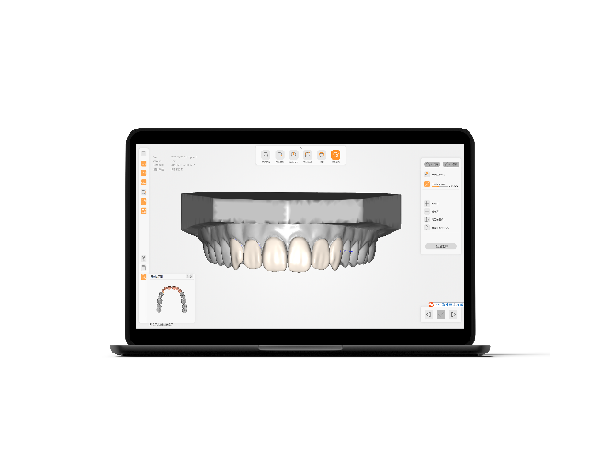
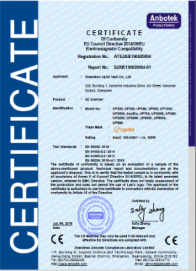
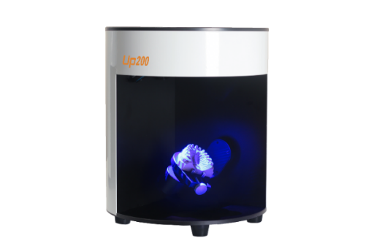
UP3D At A Glance
2010
· UPCAD project started
2013
UPCAD beta version release ·
2014
· Independent operation
· Model scanner project started
· CAM project started
· Released first scanner U1 in Dentech China
2015
UP3D attended IDS cologne ·
CE & FCC certificate ·
UP3D Shenzhen headquarter established ·
UPCAM 1.0 released ·
2016
· AcuBlu model released, the first scanner
in the world with multi-color projection.
· UP3D reach a staff member of 40
Digital Technology Improves Life
Notes:
十年磨一剑，云甲科技的研发团队十年来致力于齿科行业的解决方案，齿科产品的软硬件研发，
云甲科技的使命是，相信，数字技术改善生活。我们用数字技术的力量，让13亿中国人，拥有笑容；让民族品牌，科技力量，走向世界。

Slide 7
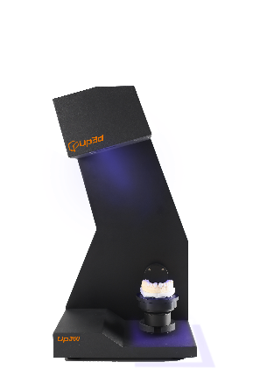
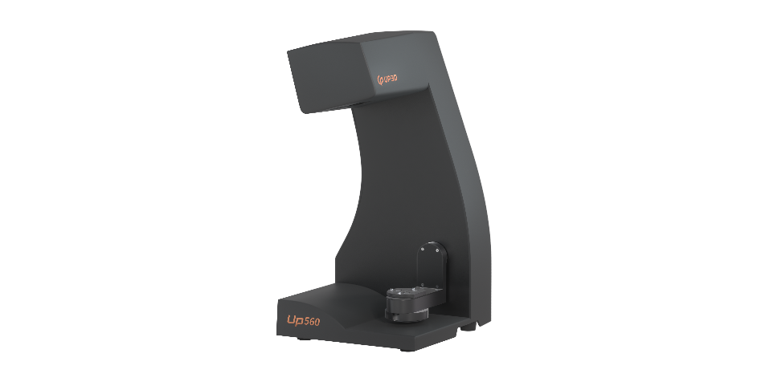
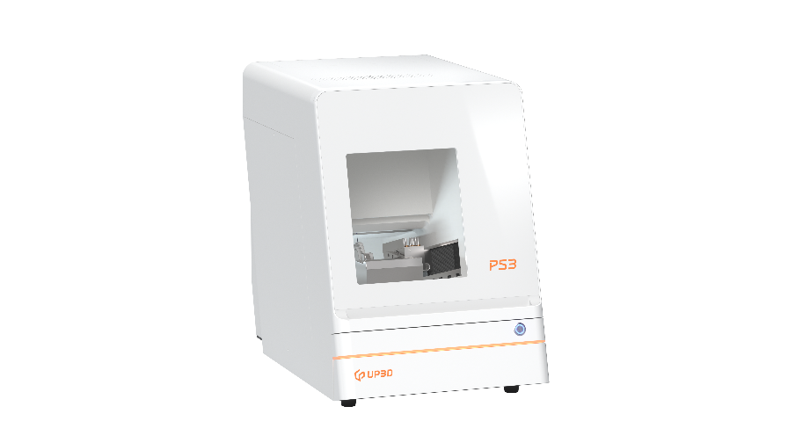
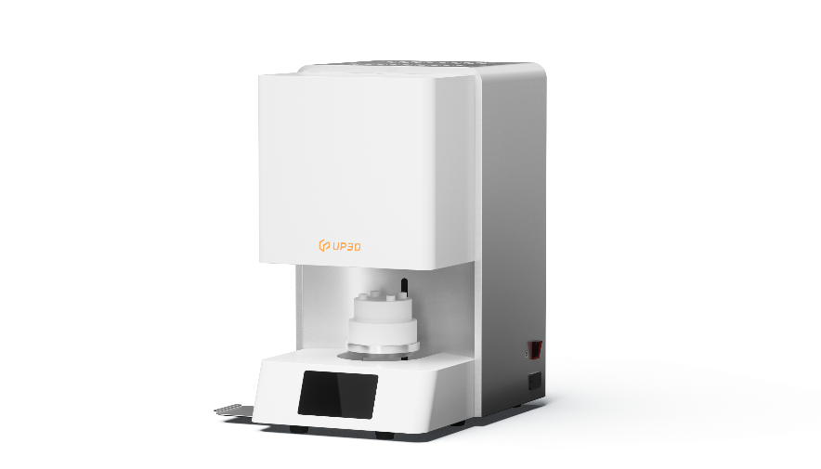
UP3D At A Glance
2017
· UPMILL project started in 2017
· Model scanner sales reached 500 sets
2018
Model scanner UP300 released ·
Unsectioned model scanner UP360 released ·
2020
· UP560 released, Ultra high speed,
true color texture, and RPDs' helper
· Smart dental milling machine P52 released
2021
Advanced model scanner UP400 released ·
Smart dental lab assistant P53 released ·
Wet dental mill P41 released ·
UP3DLINK released, contributing to smart dental labs ·
2022
· UPro10, V10, F20 released,
completing the whole dental
CAD/CAM Solution
Digital Technology Improves Life
Notes:
十年磨一剑，云甲科技的研发团队十年来致力于齿科行业的解决方案，齿科产品的软硬件研发，
云甲科技的使命是，相信，数字技术改善生活。我们用数字技术的力量，让13亿中国人，拥有笑容；让民族品牌，科技力量，走向世界。

Slide 8
UP3D Around the World
UP3D products are supplied in more than 120 countries and regions.
Over 4,800 installations in China.
More than 8,000 units to overseas.
Digital Technology Improves Life
Notes:
十年磨一剑，云甲科技的研发团队十年来致力于齿科行业的解决方案，齿科产品的软硬件研发，
云甲科技的使命是，相信，数字技术改善生活。我们用数字技术的力量，让13亿中国人，拥有笑容；让民族品牌，科技力量，走向世界。

Slide 9
UP3D Around the World
Digital Technology Improves Life

Slide 10
Affiliations and Partnerships
Digital Technology Improves Life

Slide 11
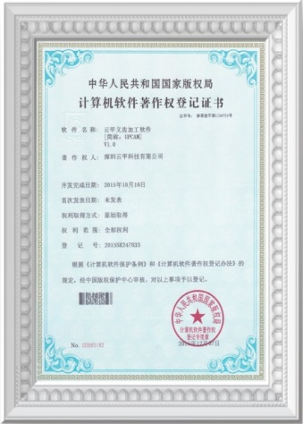
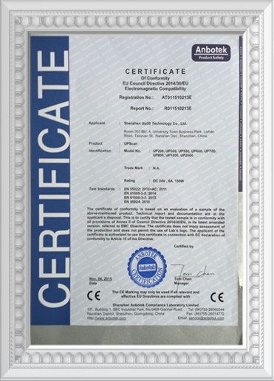
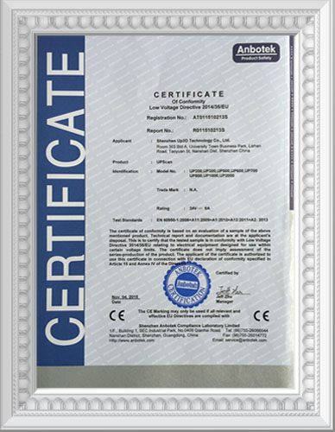
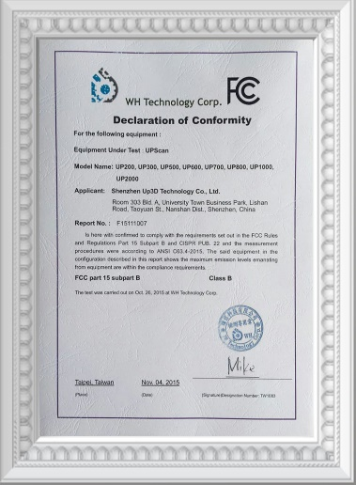
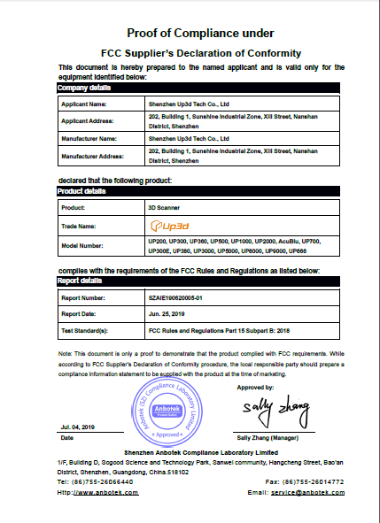
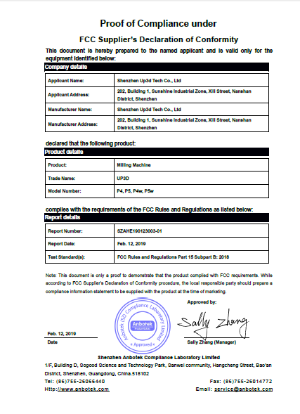
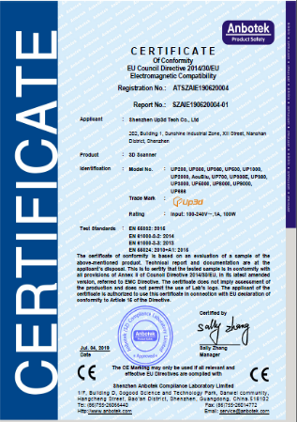
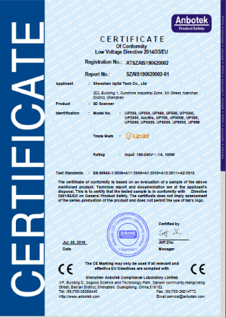
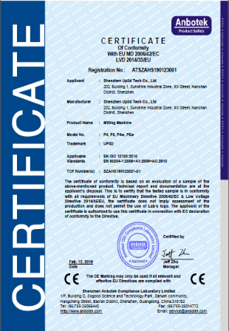
CERTIFIFCATES
A decade of in-house research and development
More than 40 libraries of 3D image core algorithms
Digital Technology Improves Life

Slide 12
02
Full Dental CAD/CAM Solution

Slide 13
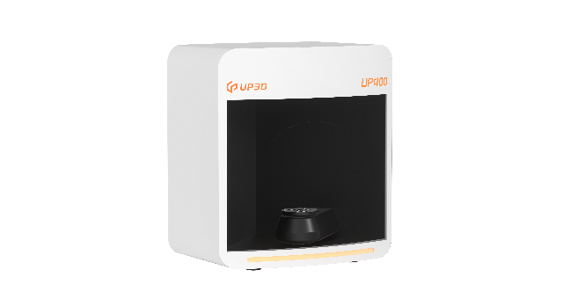
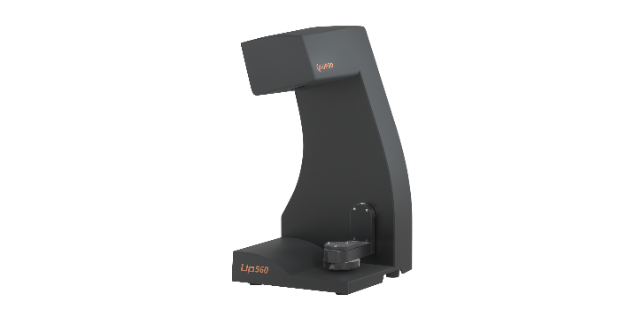
3D DENTAL SCANNER
Ultra high
speed scanner-UP400
True color texture,
RPD design experts-UP560
High speed scan
All-round solution for post and core scanning
With powerful scan engine and advanced software algorithm, UP400 is able to complete full arch scan in less than 11 seconds. We are here to speed up your digital dental workflow.
Impression and stone model integrated scan, no need for making wax-up to design the post and core precisely, improving the working efficiency.
True color texture scan
True color texture scan
UP400 brings you with most realistic result of the model and sharp scan bracket lines for better post-design by its high accuracy.
Highly restores the true color of the model to satisfy the demand of the dental technicians who are pursuing the perfect.
Personalized AI software
Output formats upgrade
New 4.0 version delivers more intuitive user interface. Based on advanced algorithm, UP400 supports real time scanning-step switching to accelerate the scanning time.
Compatible with PLY format, importing true color texture file to shape and exocad directly.
Digital Technology Improves Life

Slide 14
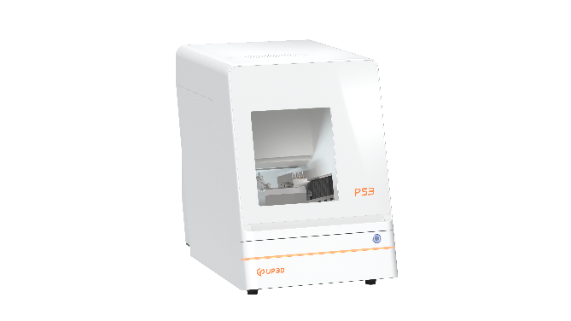
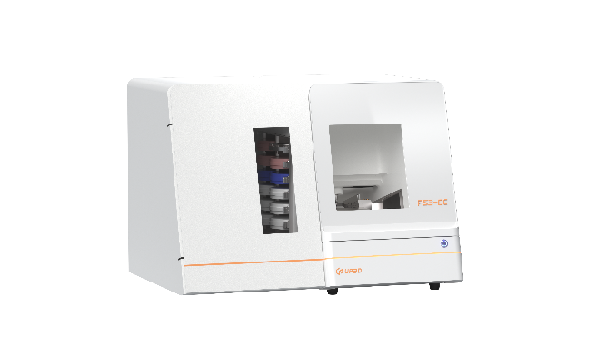
DENTAL MILLING MACHINES
Unattended Milling Machine with Auto Disc Changer-P53DC
Smart dental 5-axis milling machine-P53
90° vertical milling
90° vertical milling
The 90° milling for easy anterior incisal embrasure milling so that the P53DC can delivery the perfect results.
The 90° milling for easy anterior incisal embrasure milling so that the P53DC can delivery the perfect results.
Smart indicator
Remote Control
P53DC equipped smart LED light to indicate processing progress.
Simple setting to active intelligent 24-hour automatic milling.
Large Capacity
Large Capacity
Larger capacity supports real time blanking disc and materials switching and increase your efficiency.
Larger capacity supports real time blank disc and materials switching and increase your efficiency.
Digital Technology Improves Life

Slide 15
Comparison
Digital Technology Improves Life

Slide 16
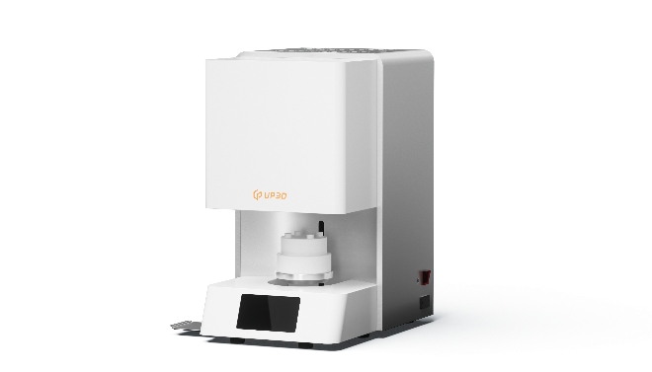
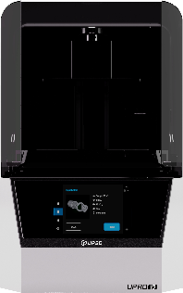
DENTAL MACHINES
Dental 3D
Printer-Upro10
Dental Sintering
Furnace-F20
Multiple applications
Power Failure Renewal
Multicable to a variety of cases: implants, orthodontics, temporary crown and removable dentures.
Continued sintering after abnormal power failure ensures efficiency sintering.
Stable and reliable
Multiple Sintering Processes
UV DLP optical machine, powered by Texas instruments, DMP chip maintenance-free for 5 years, saving your time and cost.
Professional 20 sintering programs are available.
Intelligent automation
Large Capacity
With advanced algorithm,UPro10 makes the hands-on experience.
Support 150 crowns sintering simultaneously on three sintering hold racks.
Digital Technology Improves Life

Slide 17
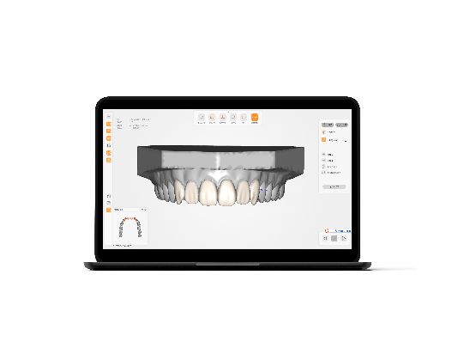
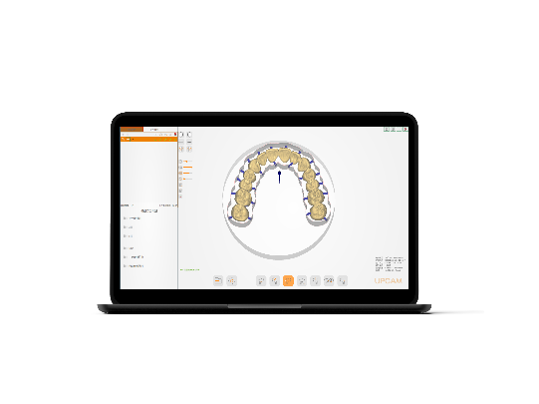
SOFTWARE
UPCAD
Design Software
UPCAD is an independently developed dental design software by UP3D since 2011, specially customized for dental technicians, and easy to learn and use. Enables users to upload database.
UPCAM
Nesting Software
UPCAM is a dental CAM software which is developed by UP3D and ModuleWorks from Germany. (Module Works is one of the most advanced CAM core algorithm supplier in the world). Suitable for all UP3D mills. UPCAM supports all types of dental restoration processing.
Digital Technology Improves Life

Slide 18
03
Marketing Events
& Support

Slide 19
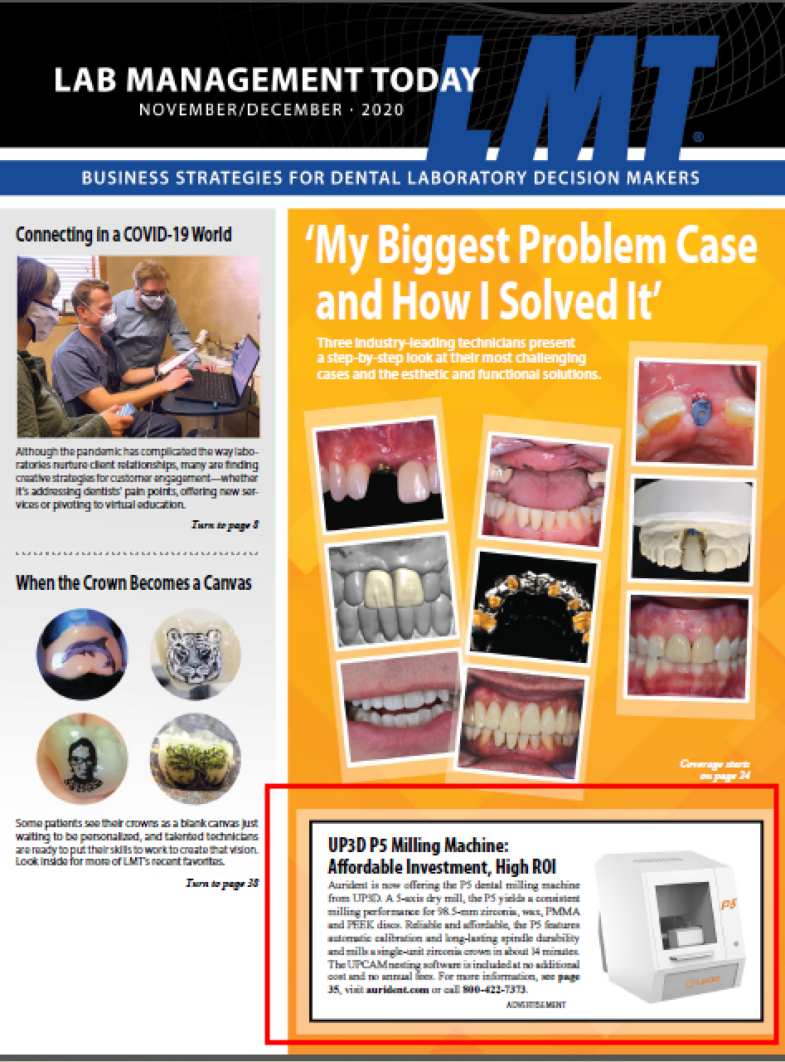
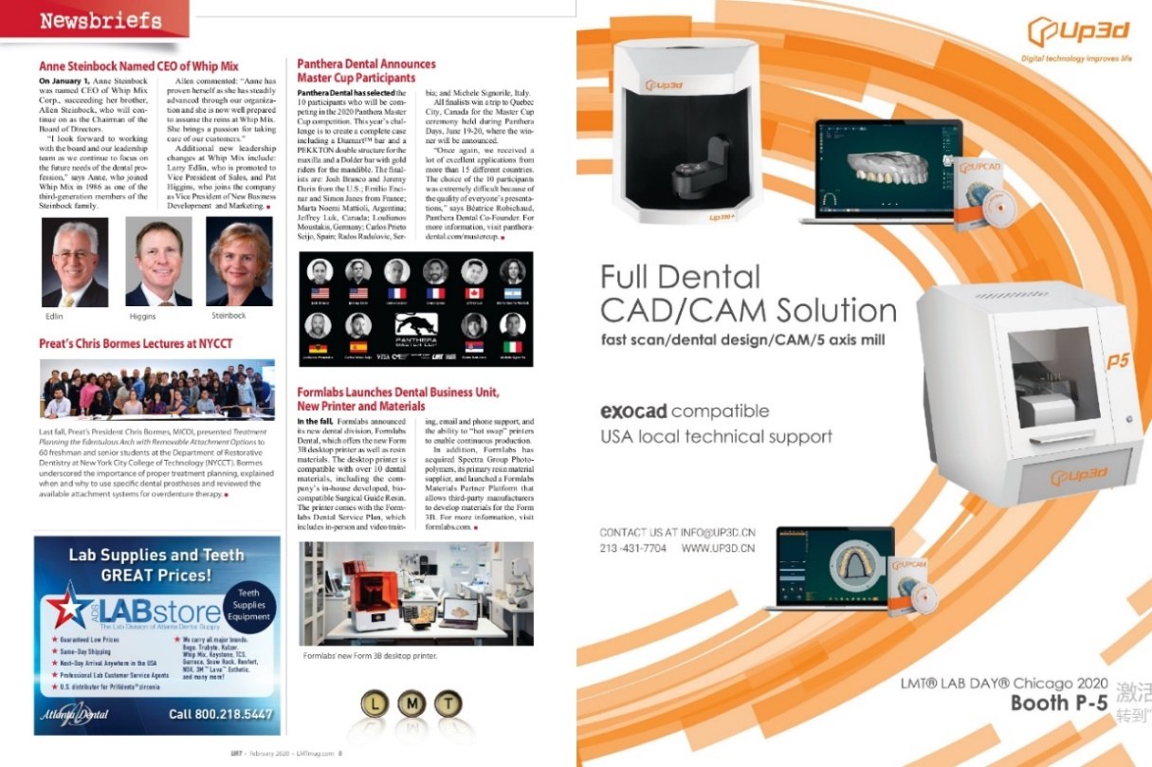
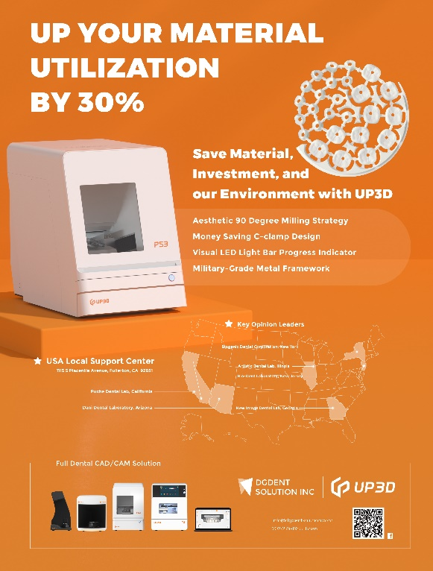
MAGAZINE - LMT
Digital Technology Improves Life

Slide 20
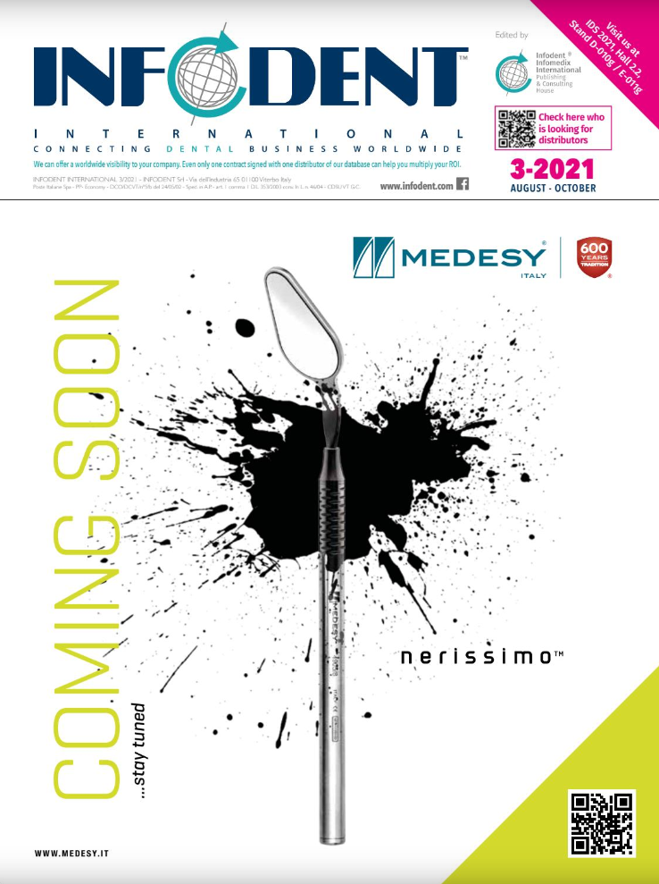
MAGAZINE - INFODENT
We advertised in the EU's most authoritative and popular dental magazine, INFODENT
Digital Technology Improves Life

Slide 21
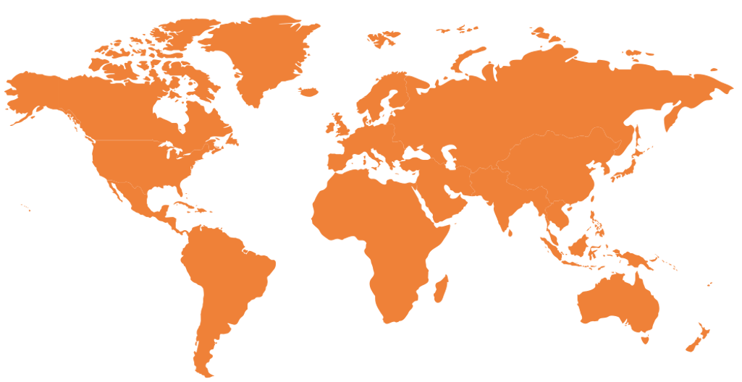
EXHIBITIONS WORLDWIDE
Digital Technology Improves Life

Slide 22
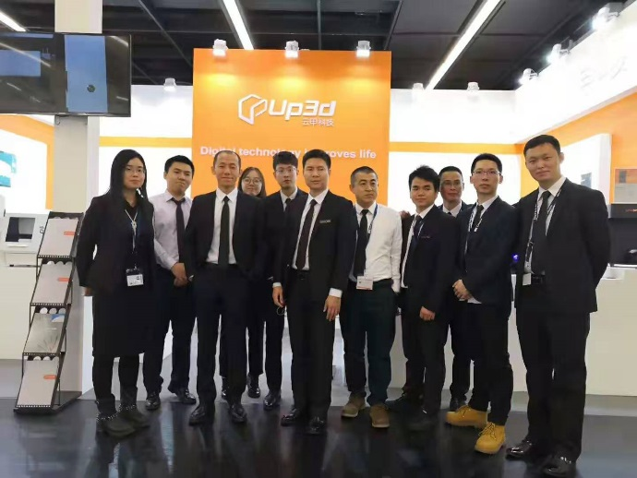
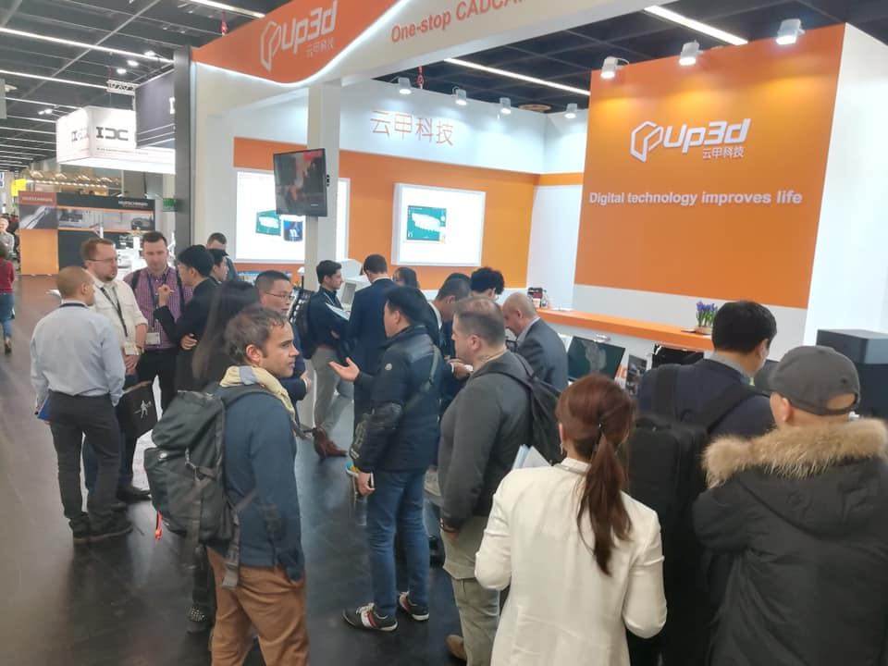
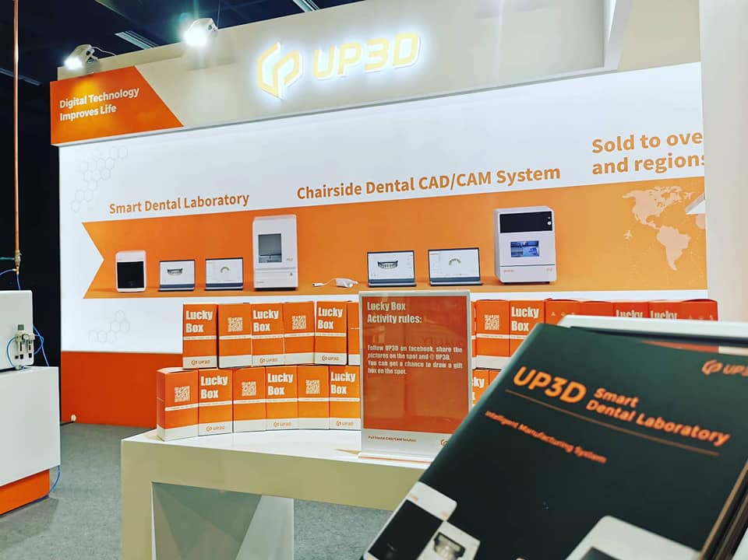
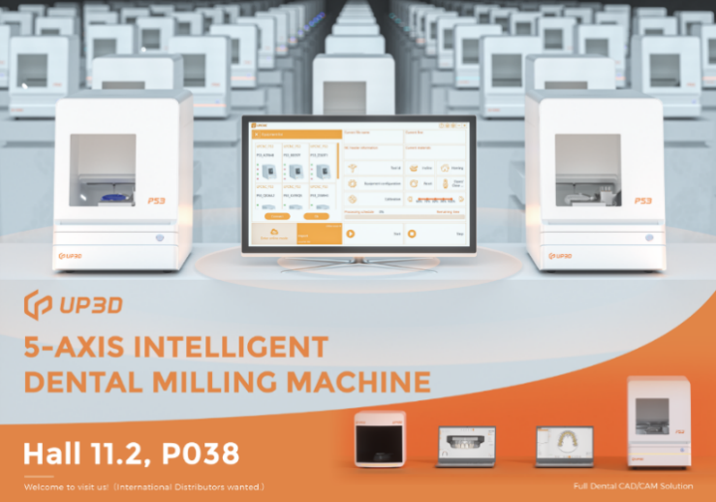
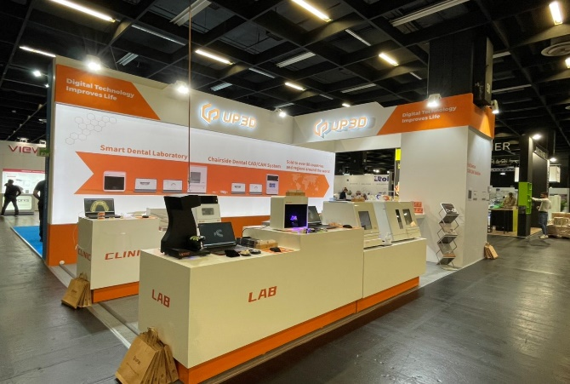
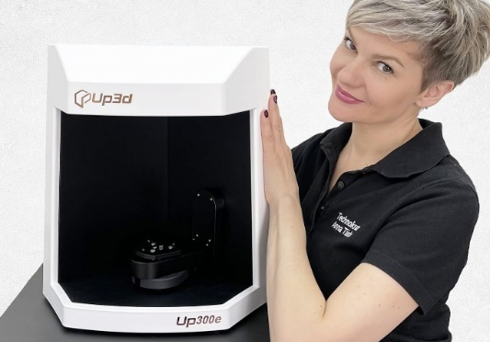
EXHIBITIONS
Digital Technology Improves Life

Slide 23
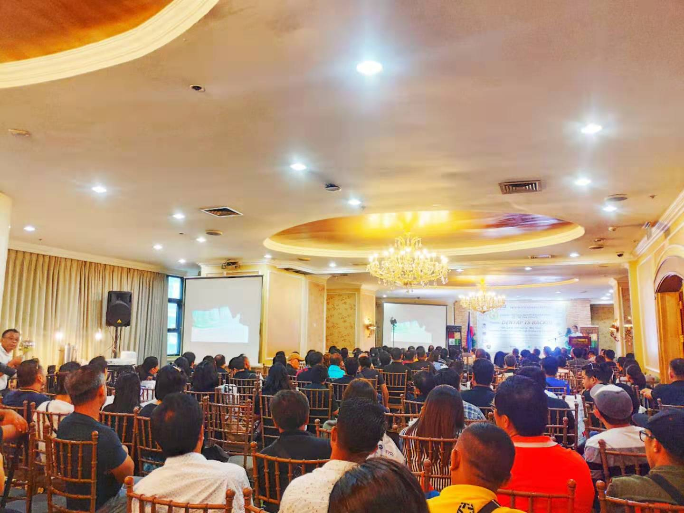
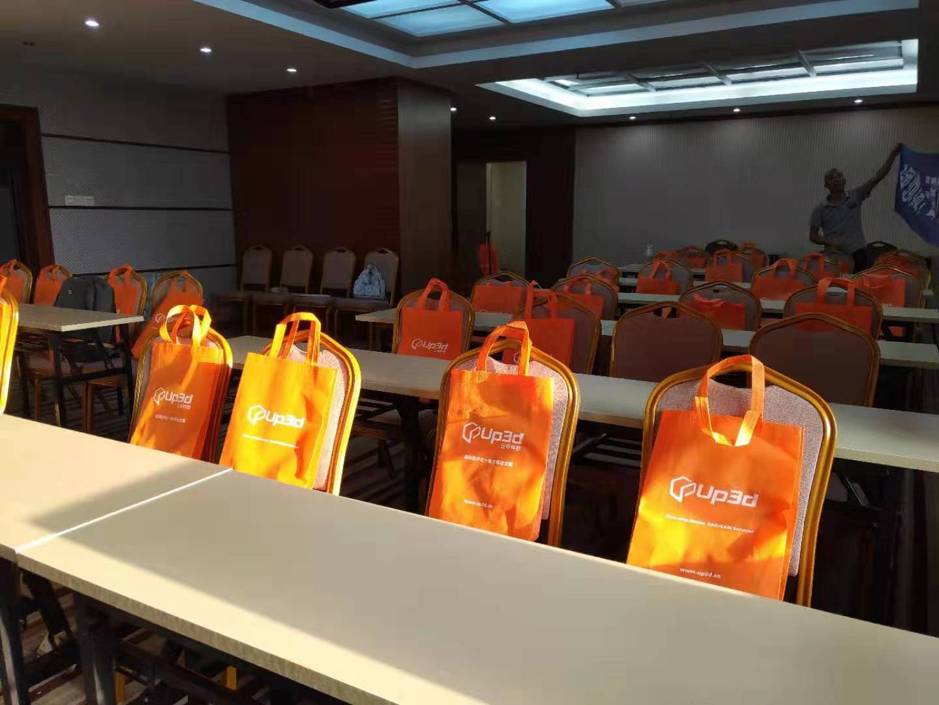
SUPPORT
Training & Marketing
Your satisfaction is our persuit.
Onsite Training & Online Training
onsite training or online training are available for you when you receive your product.
Local Marketing Activities
We can help you to do local marketing activities, such as exhibitions, magazines, new products release conference, etc.
Considerable profit with less concerns
Affordable price for end users. Professional R&D team and technical team make the products stand out and assure you solve issues immediately.
Digital Technology Improves Life

Slide 24
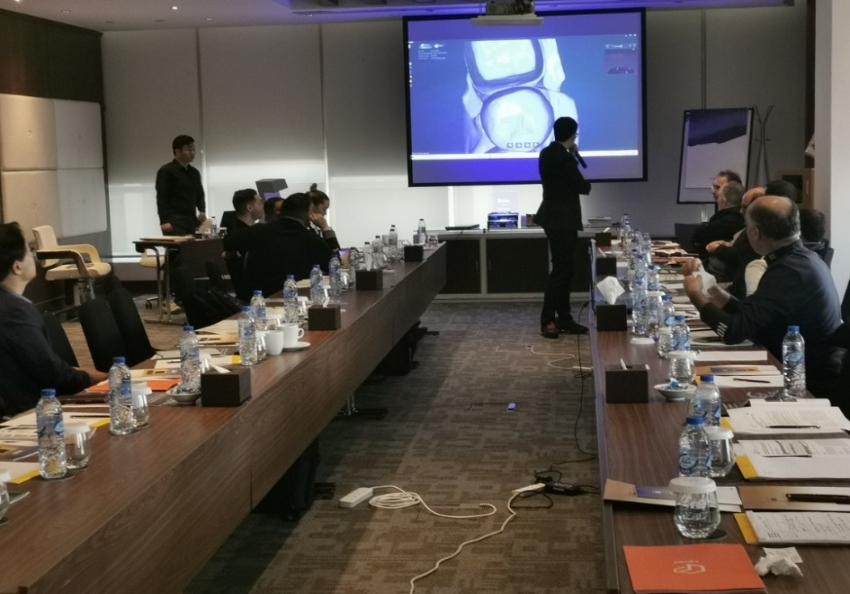
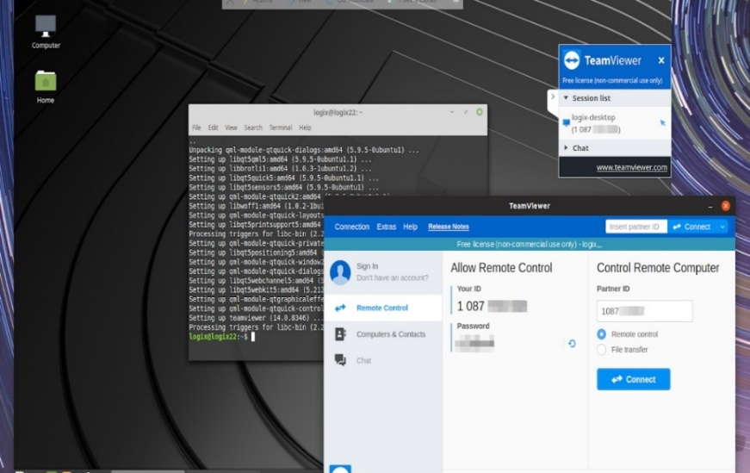
SUPPORT
Pre-sales & After-sales
Your satisfaction is our pursuit.
Quality Assurance Lab
Testing all products before delivery.
Warranty period
One year for hardware, everlasting for software
High-efficiency delivery Goods will be shipped in 3 days after payment
After-sales Guarantee
No annual fee for software, and professional technical team do the excellent services.
Digital Technology Improves Life

Slide 25
THANKS
www.up3ds.com
info@up3d.cn
Digital Technology Improves Life

